Slide 1
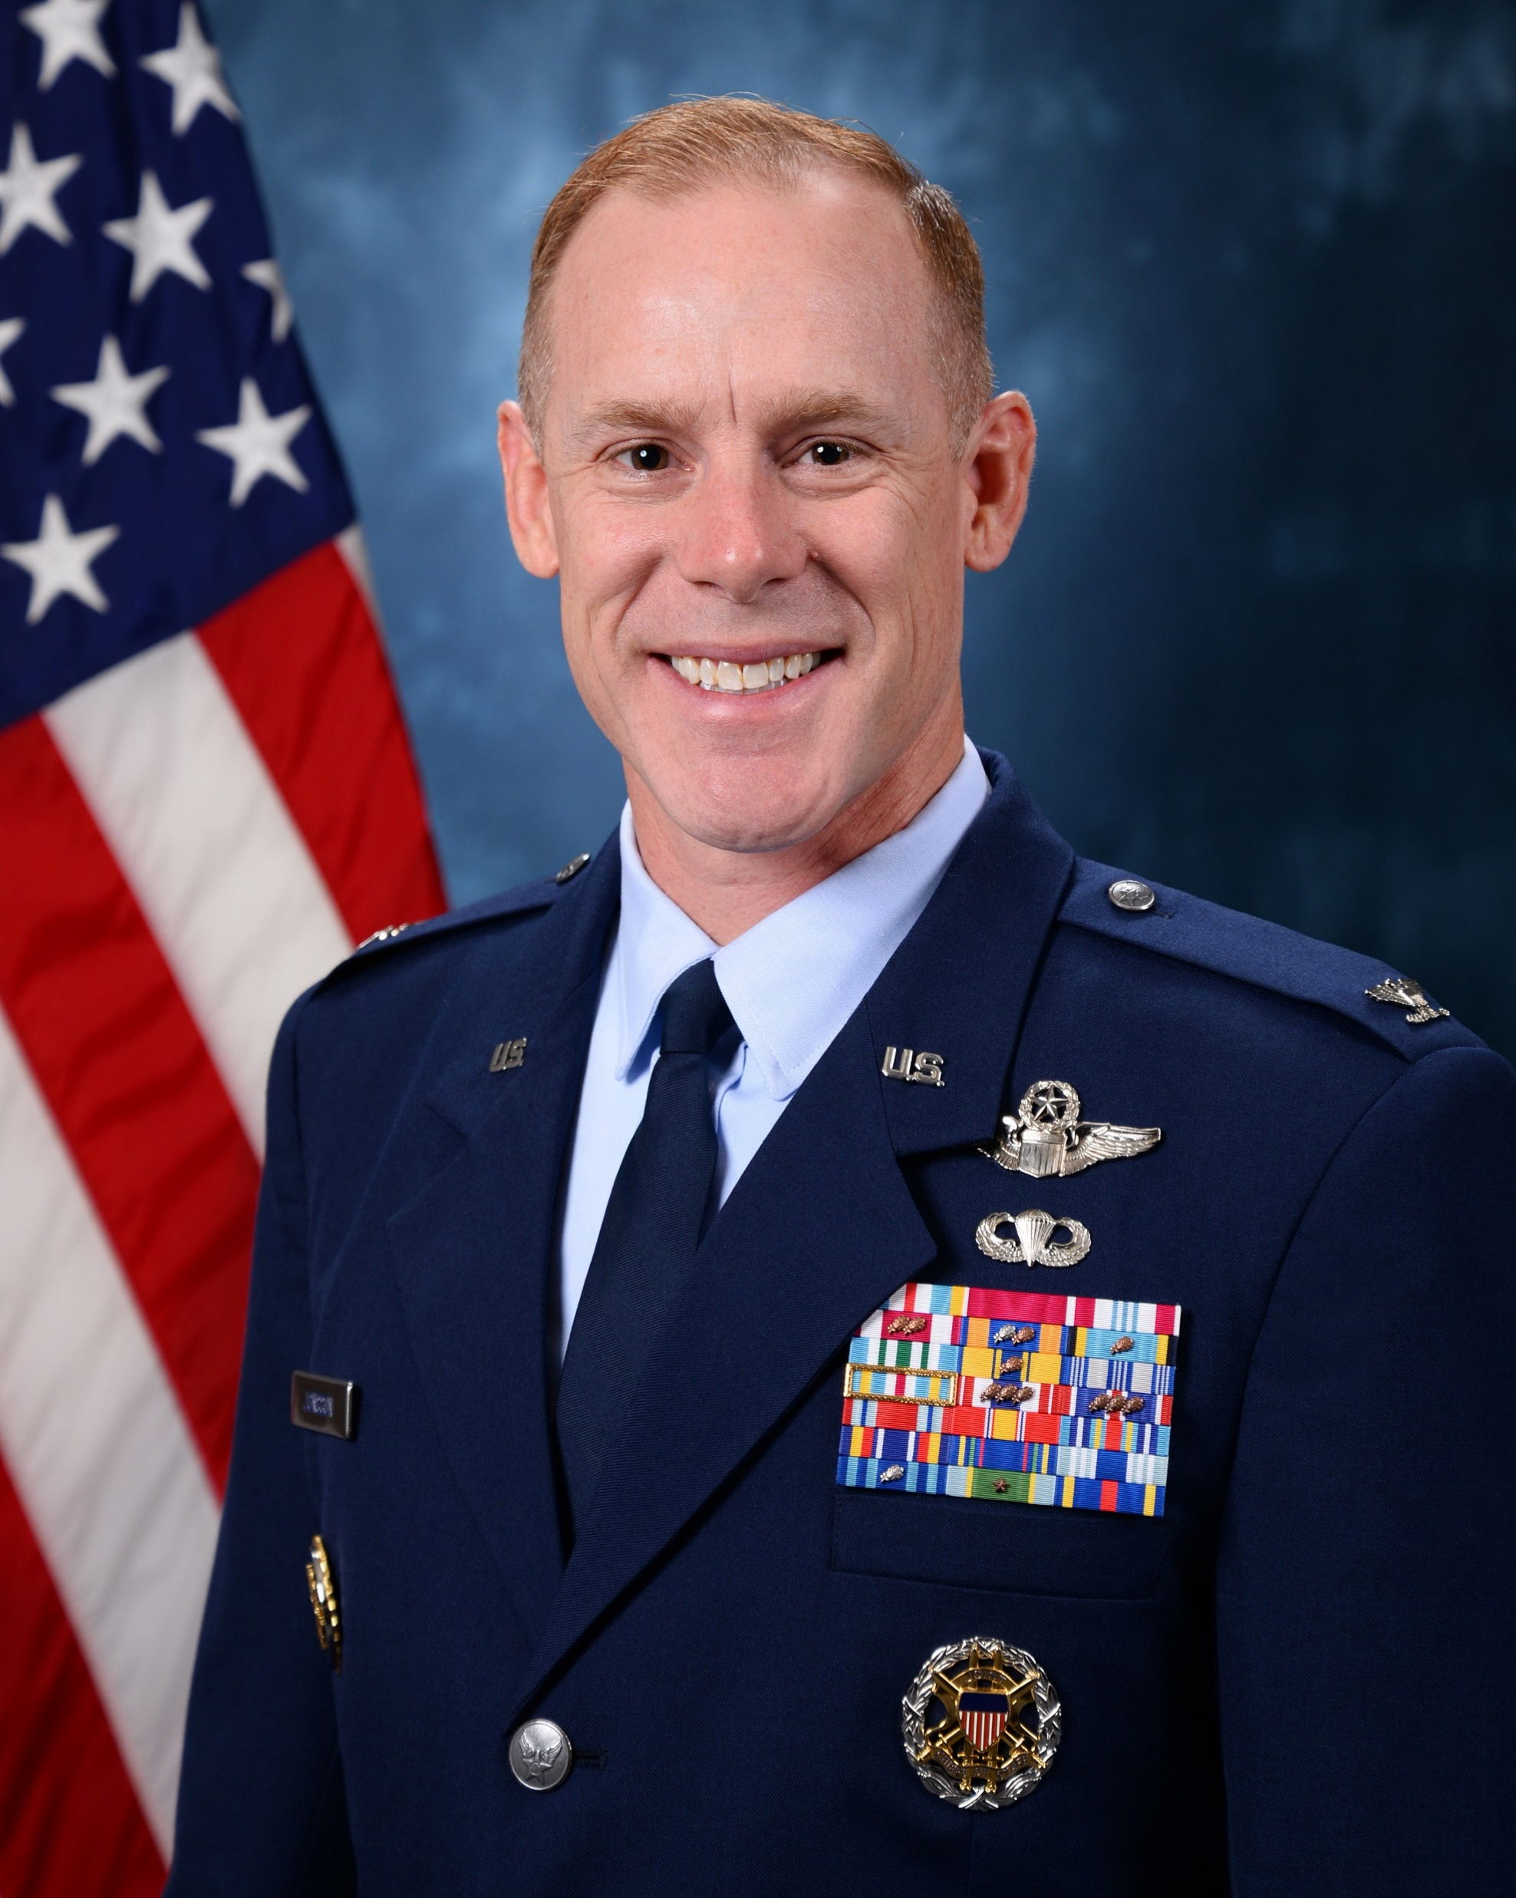
Col. Benjamin R. Jonsson (Air Force)
Published an article entitled: "Dear white colonel … we must address our blind spots around race”
Quoted in the article saying "Defensiveness is a predictable response by white people to any discussion of racial injustice"
Says white colonels are "largely blind to institutional racism"
Recommends Robin DiAngelo's “White Fragility: Why It’s So Hard for White People to Talk About Racism” at the end of the article
Helped lead diversity and inclusion panel in 2021
Serves as the Vice Superintendent of the Air Force Academy which has come under fire recently over radical DEI indoctrination
Nominated for promotion to Brigadier General on March 23, 2023

Slide 2
Brig. Gen. Scott A. Cain (Air Force)
Published "unity message" to Englin AFB after George Floyd's death
Cain appears in a video with DEI director Cecil Williams discussing the importance of "having conversations" in the aftermath of George Floyd
Says, "We really need to take a critical examination of what the truth is about diversity in our ranks…we celebrate diversity for its strength, but we need to have a conversation about what it really means”
"Everyone on our team is coming from a different place, coming with a different perspective, and some people are coming with a bias whether it's a conscious bias or not.“
DEI director Cecil Williams mentions the importance of "unconscious bias training" which is "now more critical than ever”
Cain oversaw the implementation of a DEI office at Englin AFB (under the leadership of Cecil Williams), one of the first in the Air Force, after Floyd's death
Cain called the creation of the DEI office his "most long-standing and significant accomplishment" in exit interview
Participated (and maybe spearheaded?) a Black Health and Wellness Panel at Englin AFB in which he is quoted saying “whether it’s race, discrimination or sexism issues, these issues are being more recognized. I hope for more evidence those behaviors are decreasing or going away. I want to see evidence that the fact we are all talking about those subjects more, leads to change.”
Cain had to call a safety pause after two back-to-back stealth fighter crashes within days in 2020
Two years later, he oversaw the creation of a 2500 sq. ft. gaming center for junior airmen which costed over $1 million
Nominated for promotion to Major General, and recently assumed command of Air Force Research Laboratory on March 28, 2023

Slide 3
Maj. Gen. Anthony R. Hale (Army)
Hale visited 14 HBCUs to diversify the Military Intelligence Corps
Quoted saying “And as we look at diversity, equity and inclusion, getting after and doing something about the diversity within our M-I Corps just makes us better.”
“I have been visiting Historically Black Colleges and Universities for the last year of my command of Fort Huachuca because I made it my objective to get on a campaign to recruit more minorities in the Intel Corps,” Hale said.
Made a Pride Month statement in 2021 and shared it to his Twitter
Nominated for promotion to Lieutenant General on June 13, 2023

Slide 4
Rear Adm. Shoshana Chatfield (Navy)
Advocated for women’s rights in the Navy as early as 1993
Talks about “#dei” in LinkedIn bio
Made two separate LinkedIn posts supporting the 2022 CNAF DEI Summit she attended
Gave speech at Women’s Equality Day event in 2015
In this speech she discussed the importance of overcoming barriers
She mentioned that 80% of the legislators in Congress are men which means that most of the issues that become bills and laws are only important to men, saying “it seems a bit unequal what issues go forward.”
Quoted saying “our diversity is our strength”
Concluded her discussion on the importance of equal rights by quoting Slide 35 of the Defense Equal Opportunity Management Institute's informational presentation on Women's Equality Day: “Investing in gender equality and women's empowerment can unlock human potential on a transformational scale.”
Nominated for promotion to Vice Admiral and assignment as U.S. military representative to the NATO Military Committee, Brussels, Belgium on March 23, 2023

Slide 5
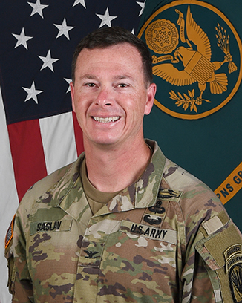
Col. Andrew o. saslav (army)
Commented "Beautiful" under LinkedIn post featuring poem on colorism and systemic racism
Pro-gun control tweet
Pro-choice and pro-gun control retweet
Pro-transgender retweet
Church and state separation retweet
Jan 6 retweet
Anti-Trump retweet
Saslav has countless other retweets of this nature
Nominated for promotion to Brigadier General on March 23, 2023

Slide 6
Lt. Gen. Kevin B. Schneider (Air Force)
Vocally discusses and supports the DEI agenda in a YouTube interview
“We’re trying to eliminate the barriers, open the doors and make sure that we can have the best most capable force that our nation can provide.”
Schneider says we will know we’ve made considerable gains with respect to diversity, equity, and inclusion when it becomes “part of our DNA”
He says DEI is an issue for leadership at all levels that we’re going to have to continue to have conservations about
Nominated for promotion to General and assignment as next commander of Pacific Air Forces on May 17, 2023

